Slide 1
Solar car construction
By archaGgelos Secondary School

Slide 2
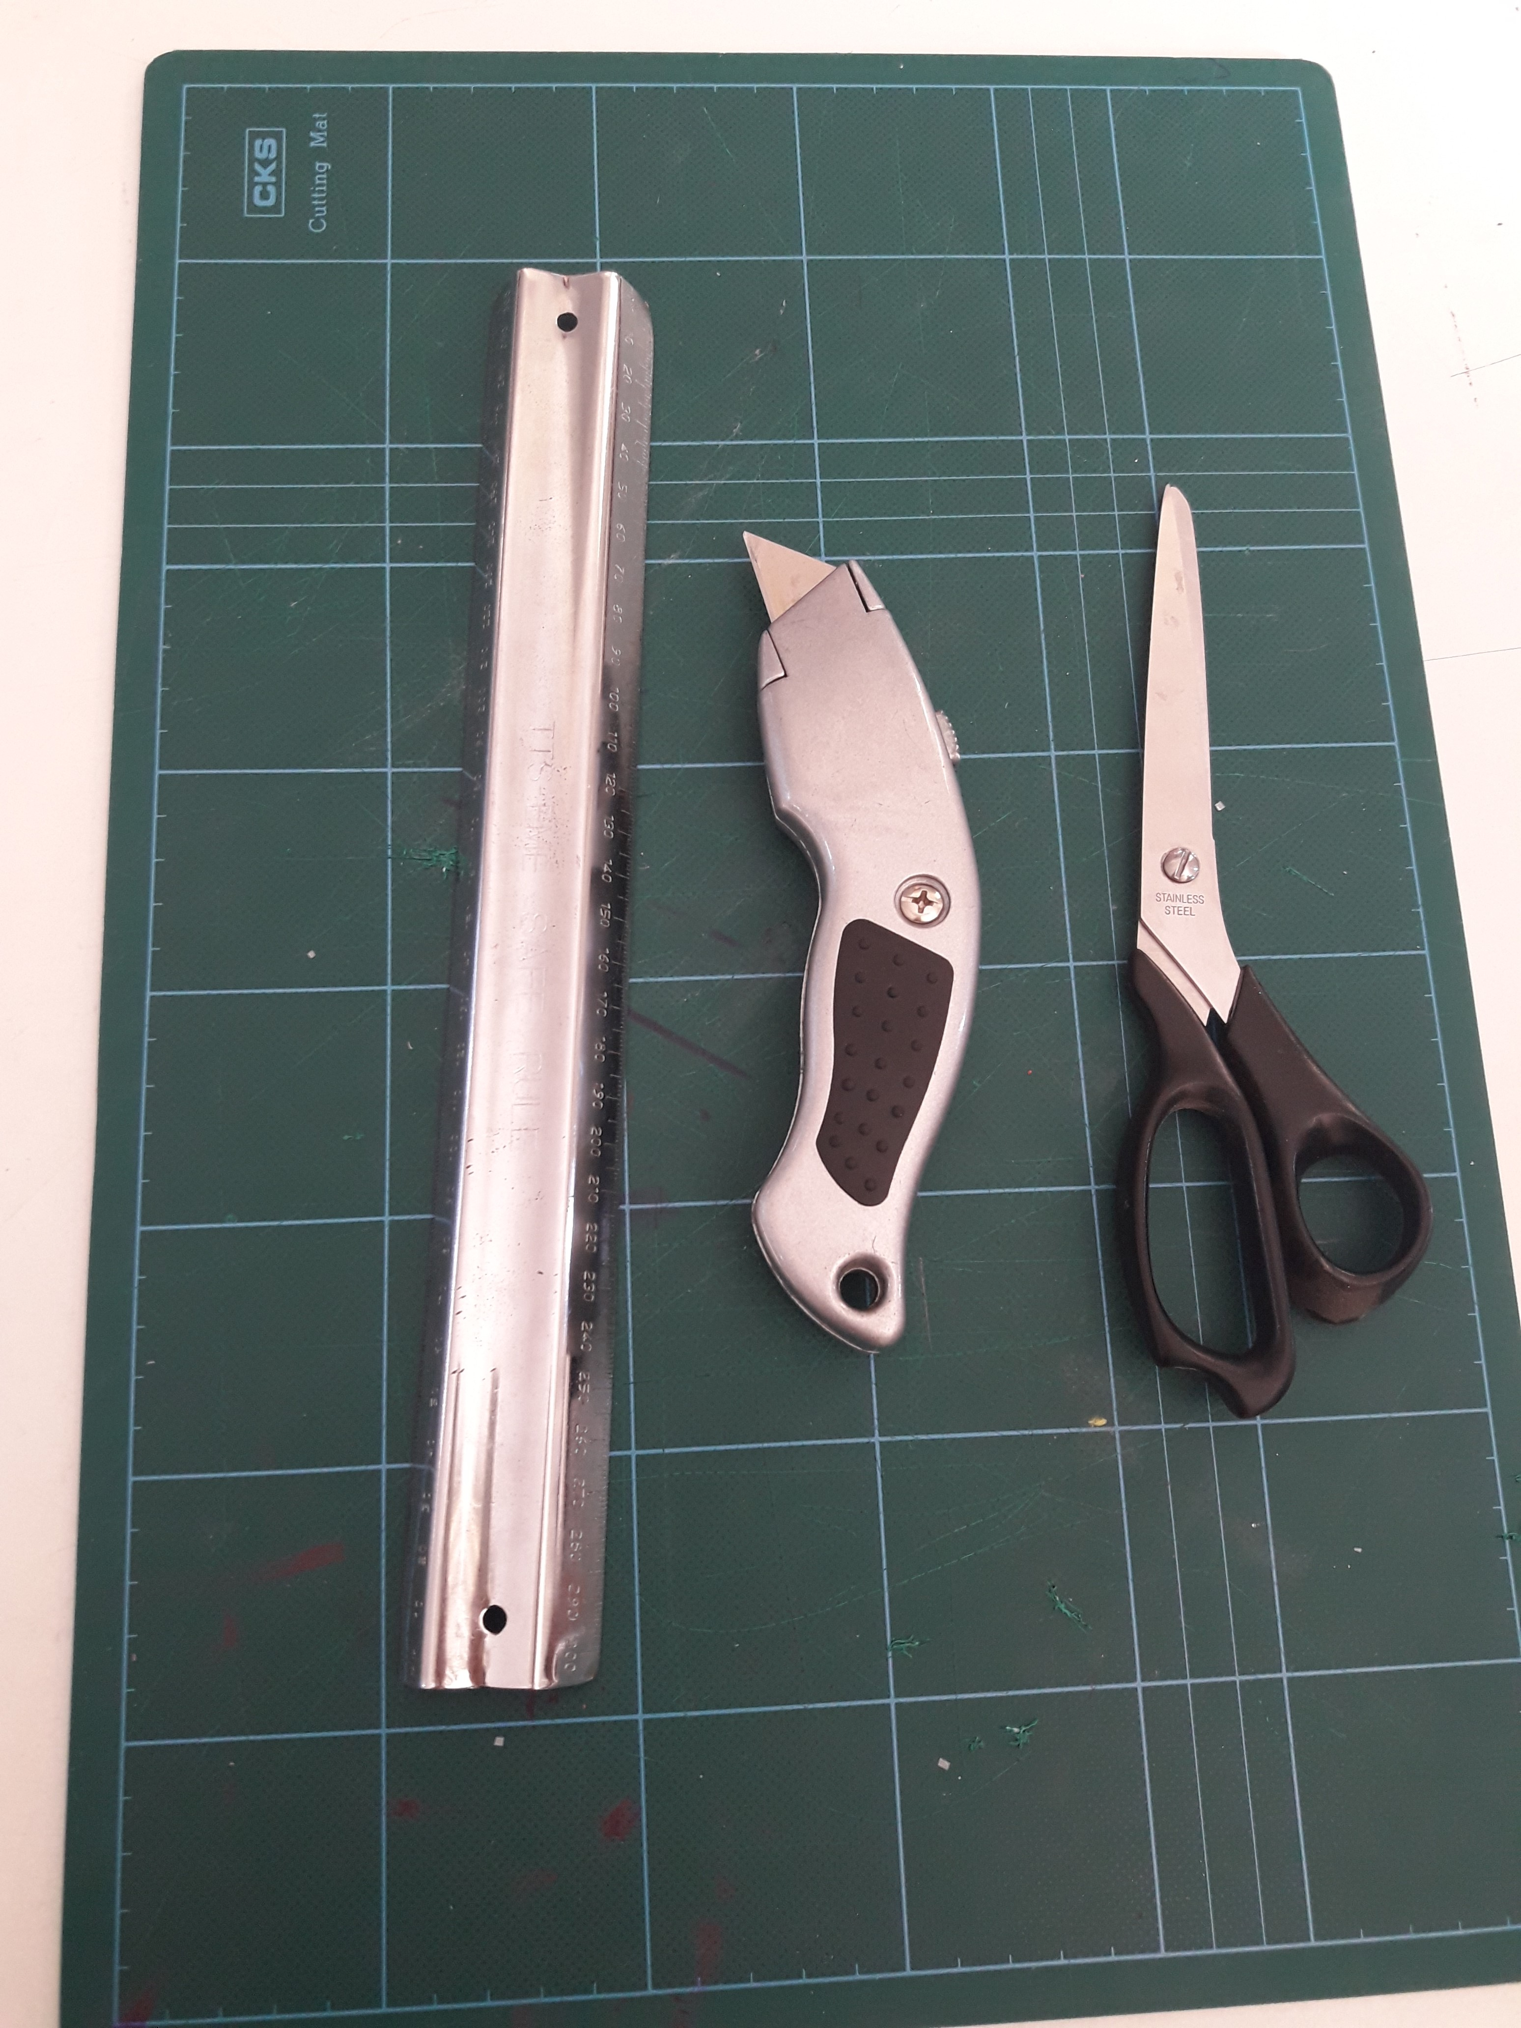
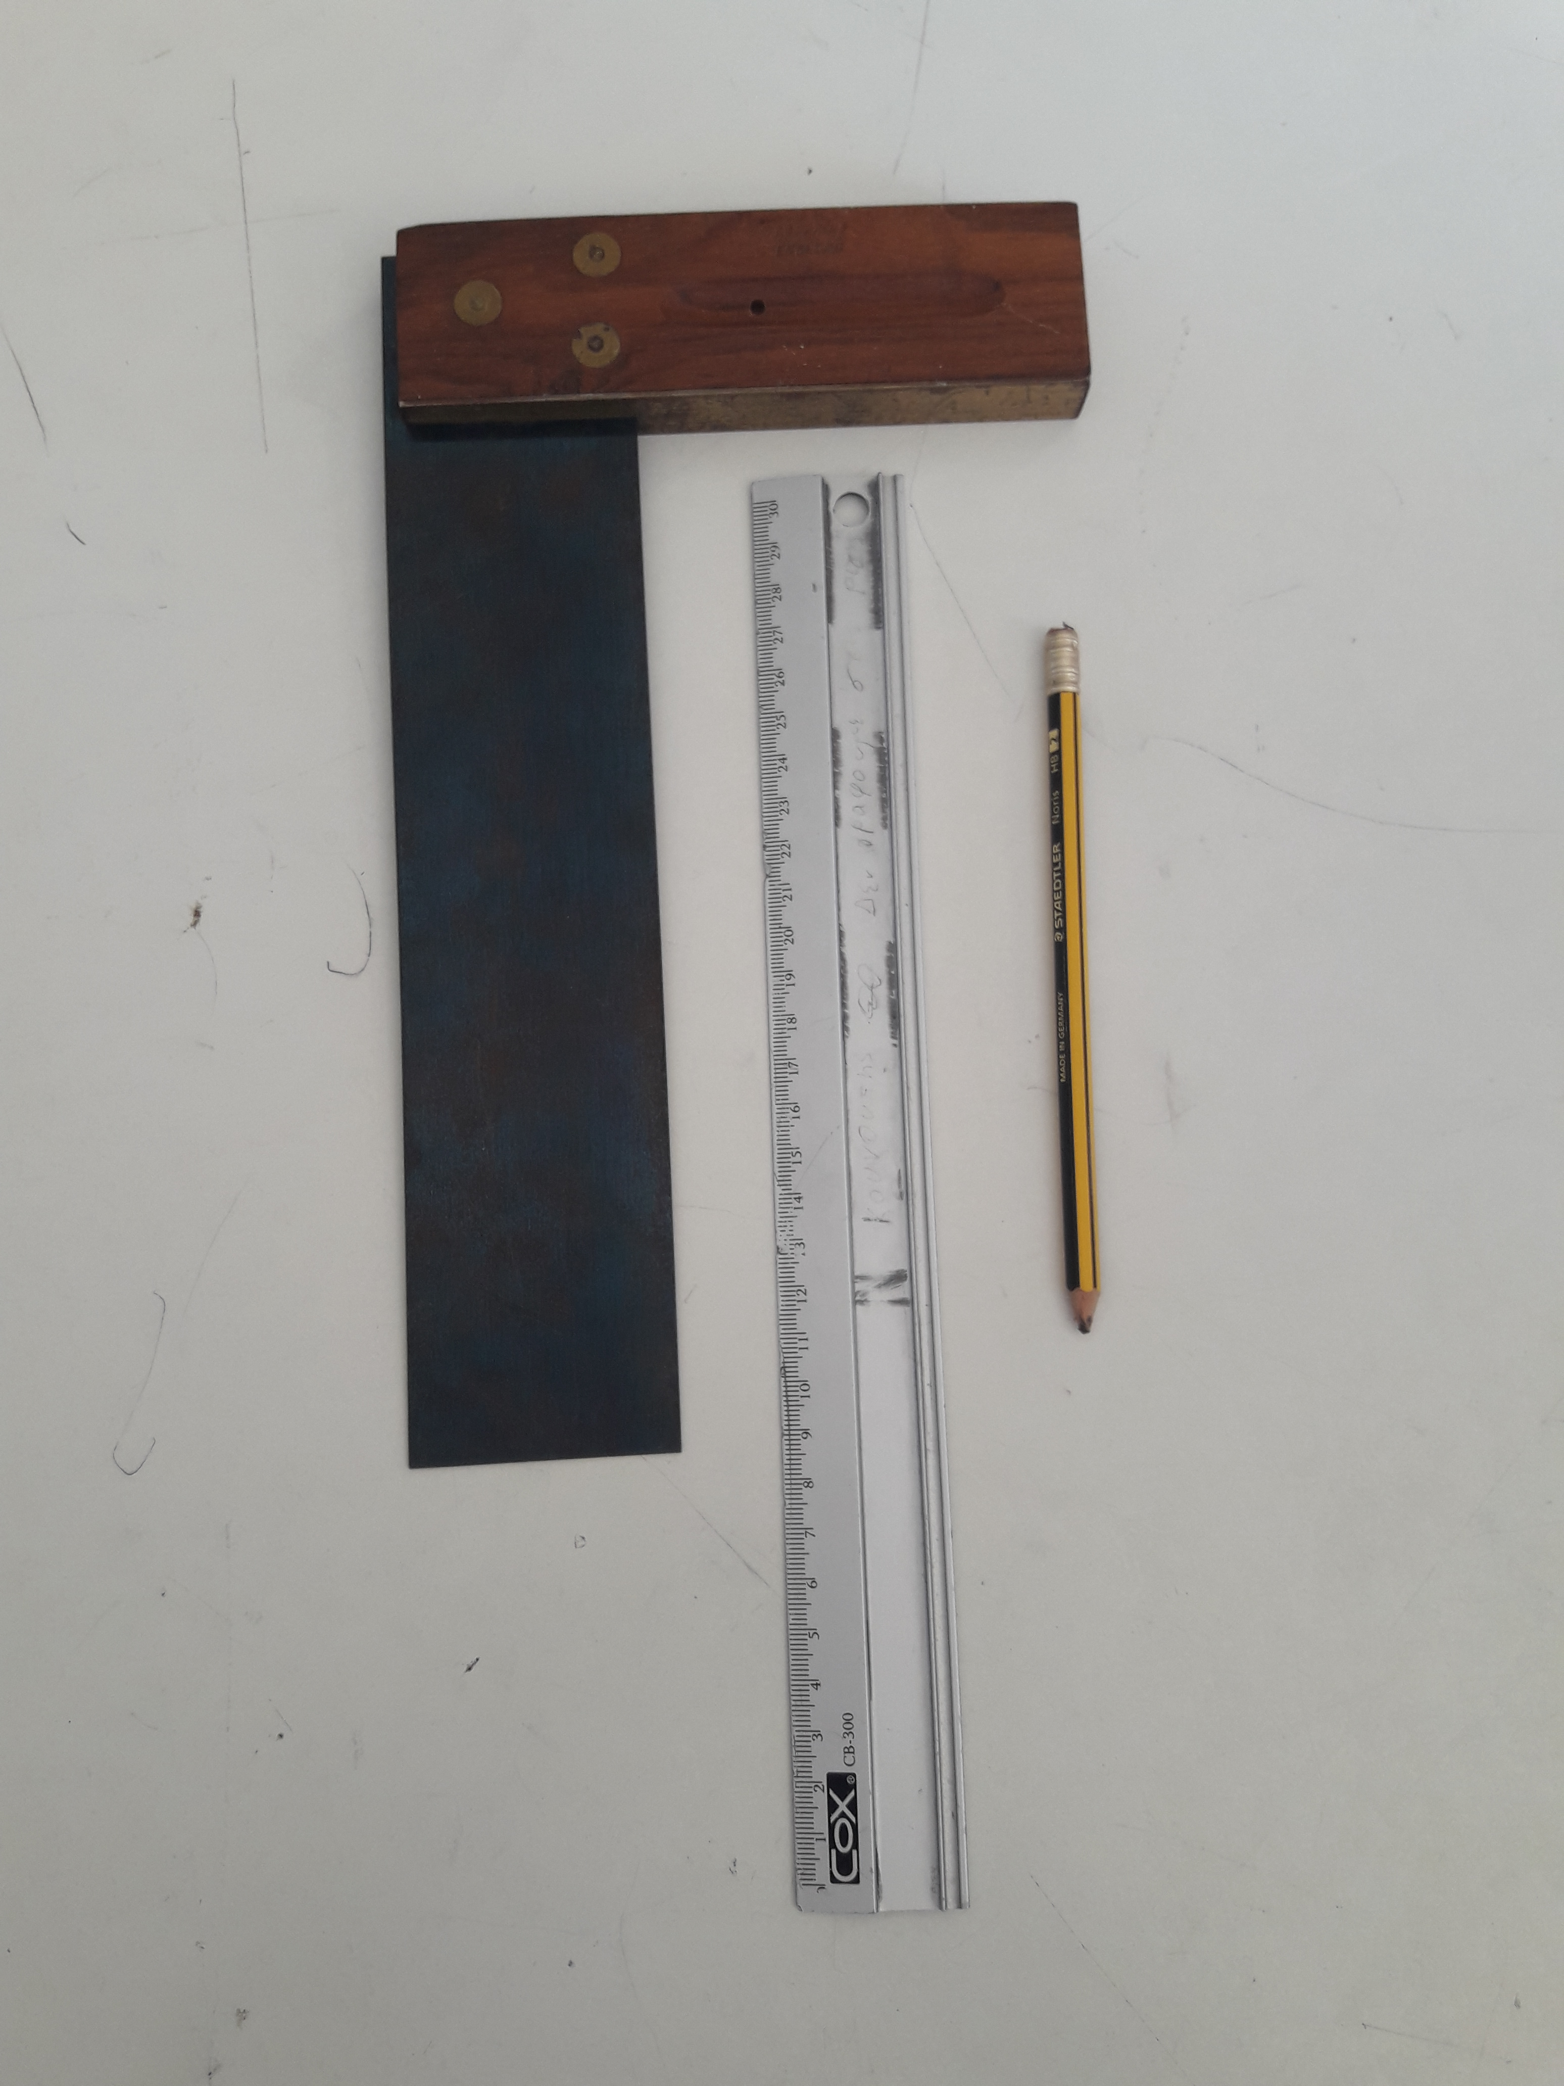
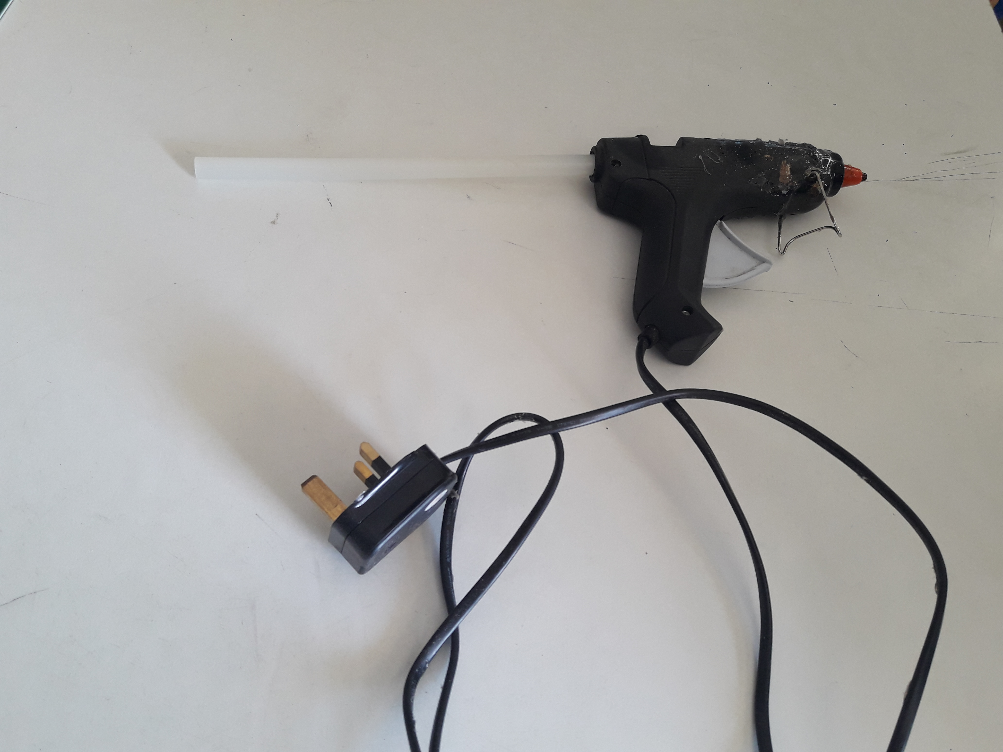
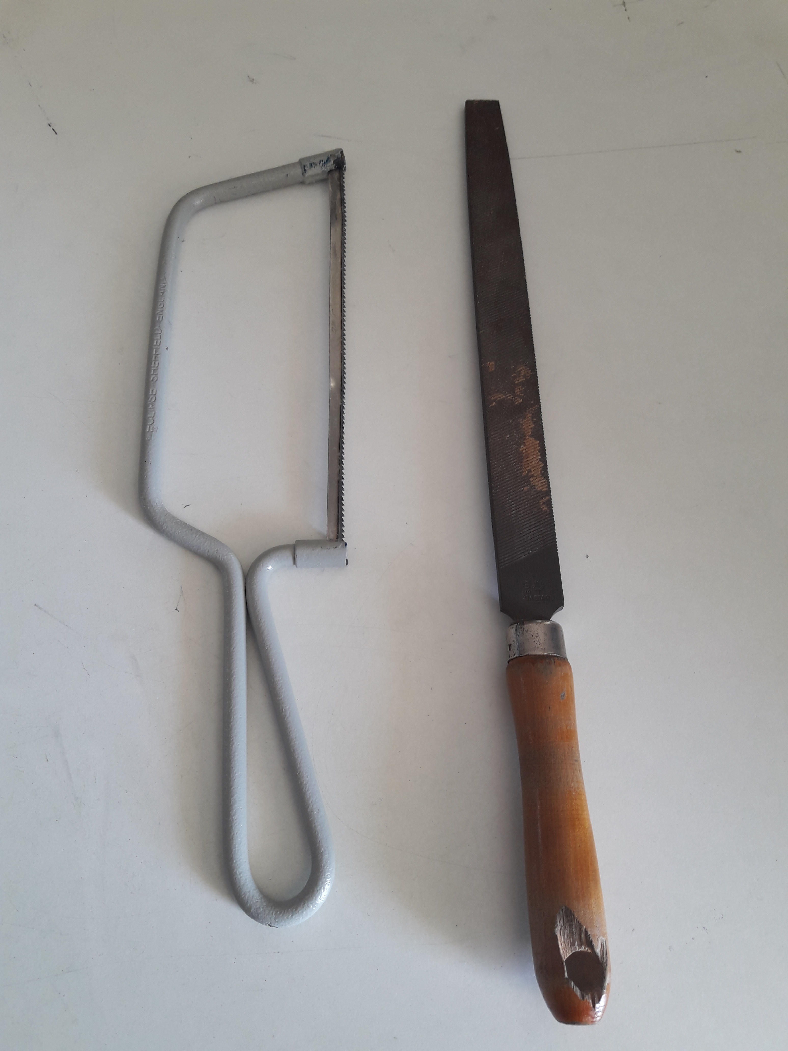
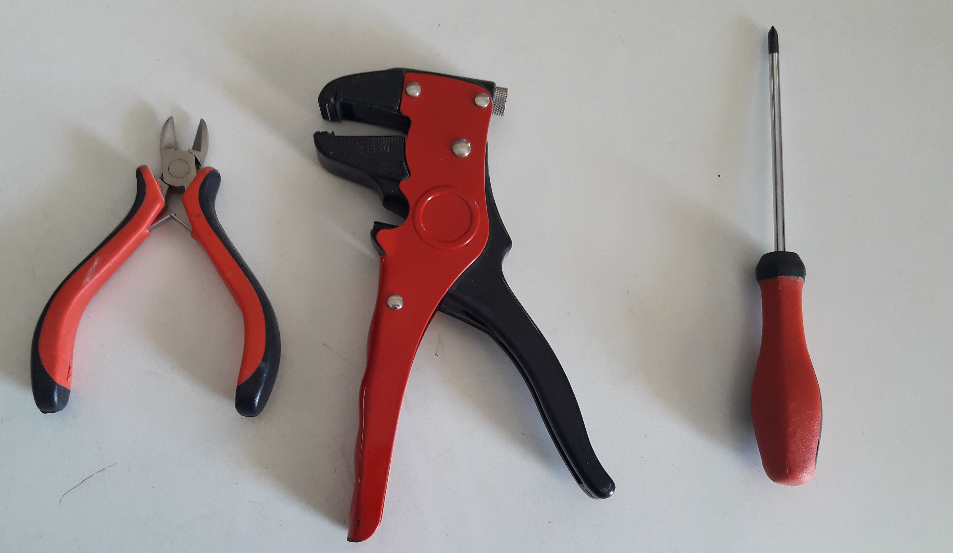

Slide 3
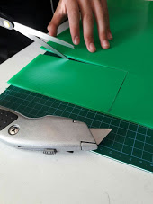
We cut a piece of coryfloud 9x16 cm using a safety ruler.

Slide 4
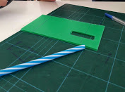
B
C
A
4cm
3cm
0.5cm
D
-Draw two lines in the coryfloud, parallel to the edges AB and CD of the rectangle, 0.5cm from the edge CD.
-Cut a rectangular hole in the coryfloud(1.5x5 cm).
-Rectangle’s distance from one edge is 4 and from the other edge is 3cm.

Slide 5
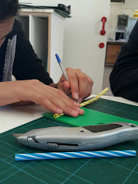
Mark and cut two straws measuring 9 cm and 7, 5 cm. We cut the 7,5 cm straw in two pieces measuring 3.5 cm and 4 cm respectively

Slide 6
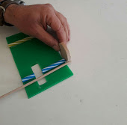
Mark two wooden axles measuring 11 cm in length.

Slide 7
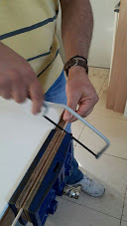
Cut carefully the two wooden axles. Not too much pressure needed. Smooth the edges with the file.

Slide 8
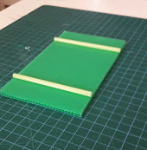
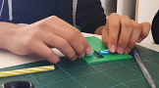
Glue the straws parallel to each other (right angle, 2 marks on each line and 3 cm distance from both edges) using hot glue. We avoid placing glue at the edges.

Slide 9
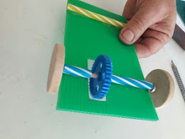
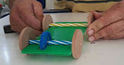
cog
washer
Pass the axle through the straws making sure that it passes through the main cog as well. We add a washer on each side of the axel to allow the wheels to move freely.

Slide 10
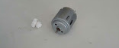
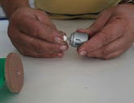
Insert the white small cog in the motor.

Slide 11
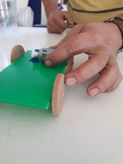
Attach the motor horizontally using hot glue to the base ensuring that the two cogs are connecting to each other

Slide 12
Cut a piece of polystyrene in a rectangular shape
B
A
Split it in half diagonally, by cutting through AB section

Slide 13
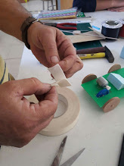
Attach the polystyrene to the base using a piece of double face tape

Slide 14
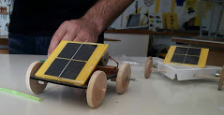
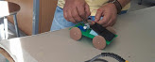
In the event of your car moving backwards,
the wires need to be inverted.
Your Solar Car is now ready!
Attach the polar panel to the polystyrene using double face tape.
Attach the wires to the motor.

